Slide 1
Automated Parcel Sorting using OCR and PTL Solution

Slide 2
We propose to build a simple and efficient mechanism presenting a generic approach towards sorting a number of parcels according to their address, pin code, weight and size using the concept of OCR based primary parcel segregation followed by secondary segregation using barcode scanner and bag identification module.

Slide 3
Currently in India Post
Small parcels like letters, pamphlets, cards etc. are sorted in an automated way in a few postal hubs.
Barcodes are scanned manually for a little heavy or voluminous parcels such as books, cosmetics etc.

Slide 4
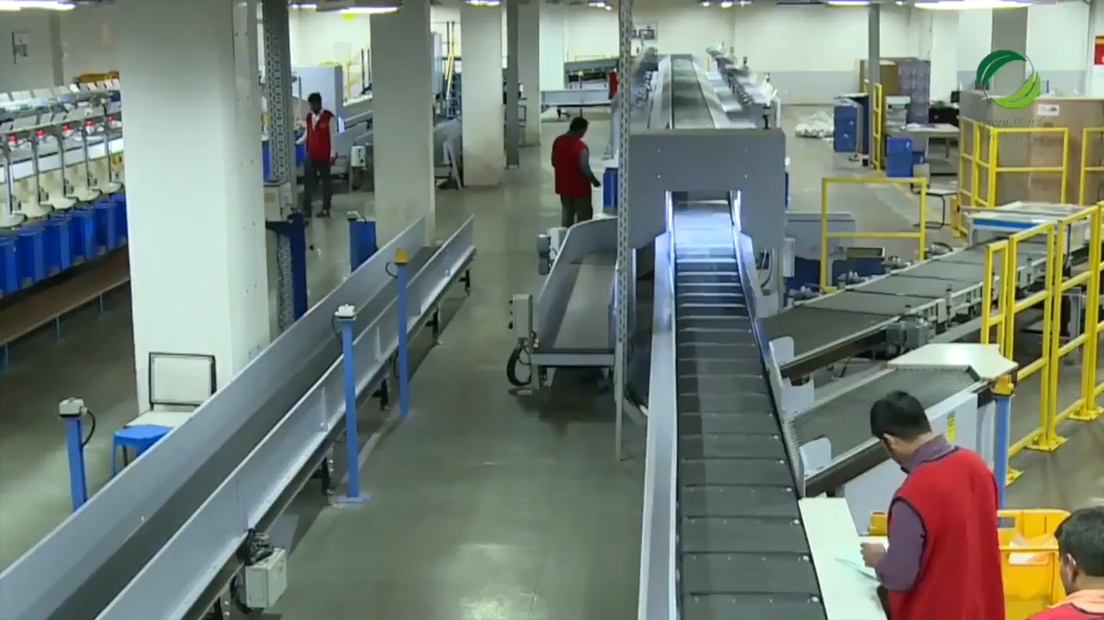

Slide 5
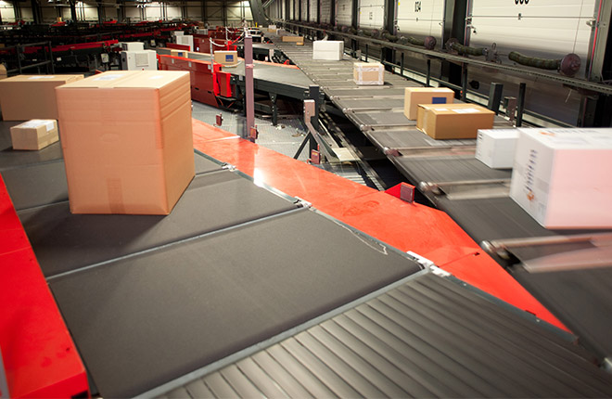
Why do we need automated parcel sorting ?

Slide 6
As e-commerce continues to surge, the case for automation is now too compelling to ignore. In the past, the volumes at postal hubs may not have required automation.
Maintaining accuracy of sorting is challenged by the increase in the volumes at the hubs. Automation helps to reduce human errors resulting in improved delivery time and customer satisfaction.
A lot of money and time is spent on either hiring skilled labour fit for sorting the parcels or training the less skilled ones to do the same. Automation saves us the time and money as well as gives opportunities to the unskilled labour to work in the hubs.

Slide 7
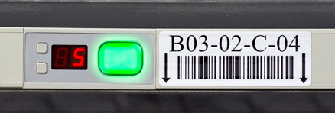
What do we mean by “Put-to-Light” solution?

Slide 8
Put-to-Light, here, means identification of the correct collecting-bag for a parcel using a light indicator by analyzing certain relevant information.
This eases our job by instantly indicating as to where the parcel belongs by scanning the barcode and analyzing the pin code contained in it.

Slide 9
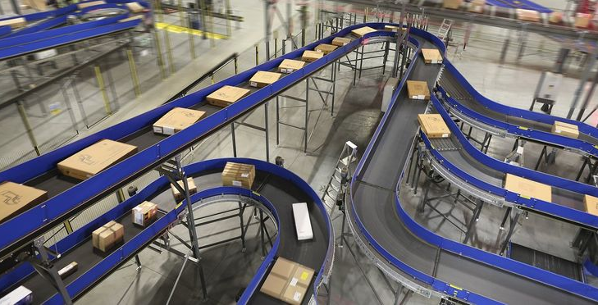
Approaching towards efficient and effective parcel sorting …

Slide 10
The packages are given a unique barcode containing information like pin code, address, weight and dimension. This information will also be stored in a local database along with the unique barcode identification (digits).
The packages are then kept on a conveyer belt. The packages are segregated on the basis of a range of pin code.
For packages to be delivered to their respective destination, secondary sorting is done by scanning the barcode of each package followed by a bag identification module.

Slide 11
This bag identification module will make use of some light indicators to determine the bag in which parcel should be placed using the information on barcode.
As a result of this automated sorting mechanism, the parcels are segregated and sent out for delivery.

Slide 12
What other mechanisms can be thought of?

Slide 13
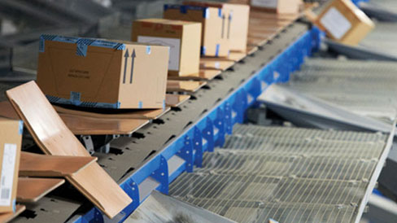
TILT TRAY SORTER
A tilt-tray sorter is a continuous-loop sortation conveyor that uses a technique of tilting a tray at a chute to slide the object into the chute.
It is a fully automated sorting mechanism.

Slide 14
Why are we not using it?
Keeping the current condition of parcel hubs in mind, installation of tilt trays in India demands extra money as some centres are already well equipped with conveyer belts.
Skilled as well as unskilled labours will be deprived of their jobs on adopting a fully automated mechanism that does not require any manual-support, hence, affecting the employment percentage.

Slide 15
Why is Put-to-Light solution better than the other solutions?
Economical: The components required such as LEDs, Microcontrollers etc are cheap and easily available in India. Other mechanisms require imported or expensive equipment for implementation.
Easy to adopt: The belts as well as the additions to the current mechanism used in various postal hubs are easy to implement and don’t require much effort.
Employment: Unskilled labour is given employment keeping in lines with various Government policies on increase of employment percentage in India.

Slide 16
Thank You

